Slide 1
Apache Shiro
Shiro is a powerful and easy to use java security framework that performs authentication, authorization, session management and cryptography.
3
Notes:
Version Date Comments
0.1 2009-9-18 Initial Version.
0.2 2009-9-23 Updated for adding more comments.
0.3 2009-12-8 Refined and approved by SDM.
1.0 2009-12-11 Refined and approved by USP.
13

Slide 2
Agent
1. What we can do with shiro?
2. Shiro feathures
3. Shiro Architecture
4. Integrate with web apps.

Slide 3
1. What we can do with shiro?
1. Authenticate a user to verify their identity.
2. Authorization: perform access control for a user.
3. Use a session API in any environment
4. Aggregate 1 or more data sources of user security data
5. Enable Single Sign On (SSO) functionality
6. Enable 'Remember Me' services for user association without login

Slide 4
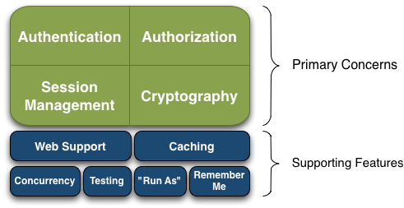
2. Shiro feathures
Authentication: Sometimes referred to as 'login', this is the act of proving a user is who they say they are.
Authorization: The process of access control, i.e. determining 'who' has access to 'what'.
Session Management: Managing user-specific sessions, even in non-web or EJB applications.
Cryptography: Keeping data secure using cryptographic algorithms while still being easy to use.

Slide 5
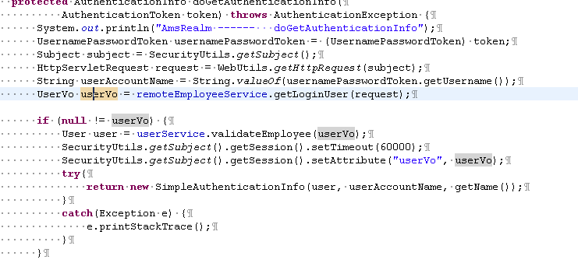
Authentication
Authentication is the process of identity verification - that is, proving a user actually is who they say they are
  For a user, they need to provide the information that to proved

Slide 6
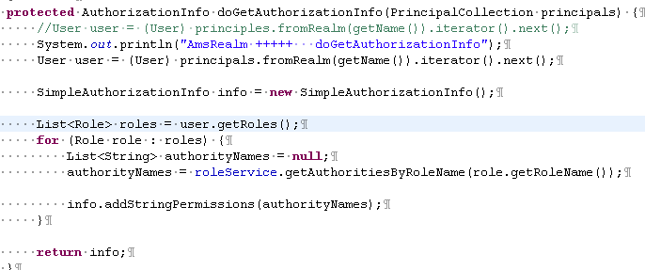
Authorization
Authorization, also known as access control, is the process of managing access to resources. In other words, controlling who has access to what in an application.

Slide 7
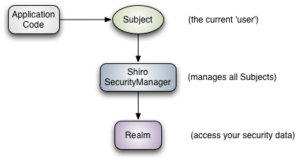
3. Shiro Architecture
Three primary concepts
Subject: The Subject is essentially a security specific 'view' of the the currently executing user. It can be a person or a 3rd-party service.
Subject instances are all bound to (and require) a SecurityManager. When you interact with a Subject, those interactions translate to subject-specific interactions with the SecurityManager.
SecurityManager: The SecurityManager is the heart of Shiro’s architecture. It used to manager all the subject.
Realm: Realms act as the ‘bridge’ or ‘connector’ between Shiro and your application’s security data.

Slide 8
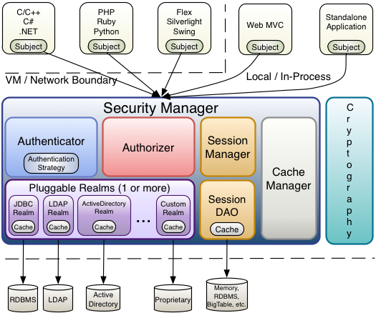
3. Shiro Architecture

Slide 9
3. Shiro Architecture
Subject (org.apache.shiro.subject.Subject)
A security-specific 'view' of the entity (user, 3rd-party service, cron job, etc) currently interacting with the software.
SecurityManager (org.apache.shiro.mgt.SecurityManager)
the heart of Shiro’s architecture
Authenticator(org.apache.shiro.authc.Authenticator)
responsible for executing and reacting to authentication (log-in) attempts by users.
  Authentication Strategy (org.apache.shiro.authc.pam.AuthenticationStrategy)
  If more than one Realm is configured, the AuthenticationStrategy will coordinate the Realms to determine the conditions under which an authentication attempt succeeds or fails (for example, if one realm succeeds but others fail, is the attempt successful? Must all realms succeed? Only the first?).
AtLeastOneSuccessfulStrategy: At least one authenticate successful
FirstSuccessfulStrategy: The first authenticate successful, the other will be ignored
AllSuccessfulStrategy: All need authenticate successful.

Slide 10
3. Shiro Architecture
Authorizer (org.apache.shiro.authz.Authorizer)
Determines subject has which permissions.
SessionManager (org.apache.shiro.session.mgt.SessionManager)
Create and manage session, user can use session in any environment(without container).
CacheManager (org.apache.shiro.cache.CacheManager)
Manage cache, reduce unnecessary request.
Cryptography (org.apache.shiro.crypto.*)
encrypt our data, easier than java api
Realms (org.apache.shiro.realm.Realm)
Realms act as the ‘bridge’ or ‘connector’ between Shiro and your application’s security data

Slide 11
4. Integrate with web apps.
shiro-all-1.2.1.jar
shiro-core-1.2.0.jar
shiro-ehcache-1.2.1.jar
shiro-spring-1.2.1.jar
shiro-web-1.2.1.jar
slf4j-api-1.5.8.jar
1. Required jars
2. Add filter in web.xml
<filter>
<filter-name>shiroFilter</filter-name>
<filter-class>org.springframework.web.filter.DelegatingFilterProxy</filter-class>
</filter>
<filter-mapping>
<filter-name>shiroFilter</filter-name>
<url-pattern>/*</url-pattern>
</filter-mapping>

Slide 12
4. Integrate with web apps.
3. Configure in Spring
<bean id="authorityFilter" class="com.augmentum.ams.filter.AuthorityFilter" />
<bean id="amsRealm" class="com.augmentum.ams.shiro.AmsRealm" />
<bean id="securityManager" class="org.apache.shiro.web.mgt.DefaultWebSecurityManager">
<property name="realm" ref="amsRealm"></property>
</bean>
<bean id="shiroFilter" class="org.apache.shiro.spring.web.ShiroFilterFactoryBean">
<property name="securityManager" ref="securityManager"></property>
<property name="loginUrl" value="/error/error"></property>
<property name="unauthorizedUrl" value="/home/error"></property>
<property name="filters">
<map>
<entry key="authc" value-ref="authorityFilter" />
</map>
</property>
<property name="filterChainDefinitions">
<value>
/error/error = anon
/css/**=anon
/js/**=anon
/images/**=anon
/asset/listAsset/** = authc,perms[Asset:view_all]
/asset/assignAsset/** = authc,perms[Asset:assign_asset]
/asset/checkInAsset/** = authc,perms[Asset:check_in_asset]
/asset/checkOutAsset/** = authc,perms[Asset:check_put_asset]
/**=authc
</value>
</property>
</bean>

Slide 13
4. Integrate with web apps.
5. Shiro annoation
@RequiresAuthentication
Need user login, equals subject.isAuthenticated() true
@RequiresUser
Two types
subject.isAuthenticated()
subject.isRemembered()
@RequiresRoles(“roleName”)
subject.hasRole();
subject.haspermissions()
@RequiresPermissions(“Asset:create”, “User:*”)
The two permissions are and relations

Slide 14
Thank you
Q&A

